Slide 1
Shopp-E : Online Shopping
Alifya Khan
Harsha Devnani
Radhika Gupte
Viraj Kamtekar

Slide 2
Overview of the project
Technologies used & Modules of the project
Technologies Used:
Angular 8
Spring Boot
Hibernate
Redis
Modules in the project:
User module
Retailer module

Slide 3
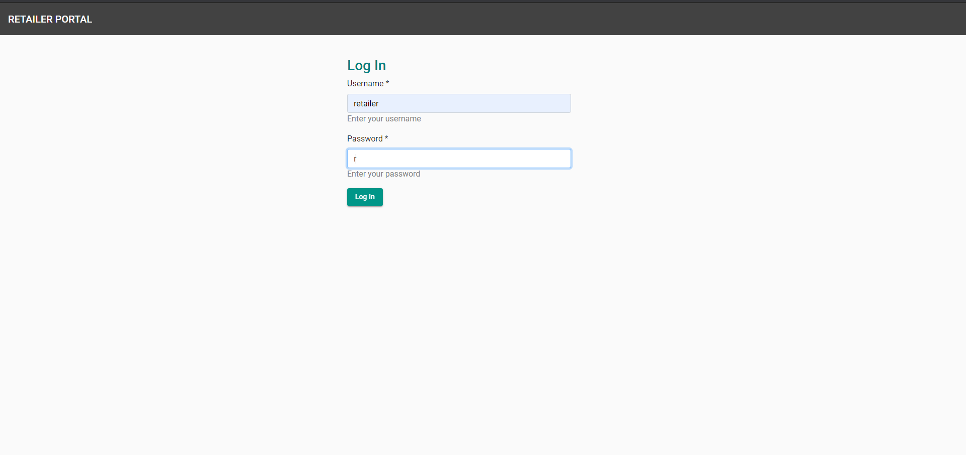
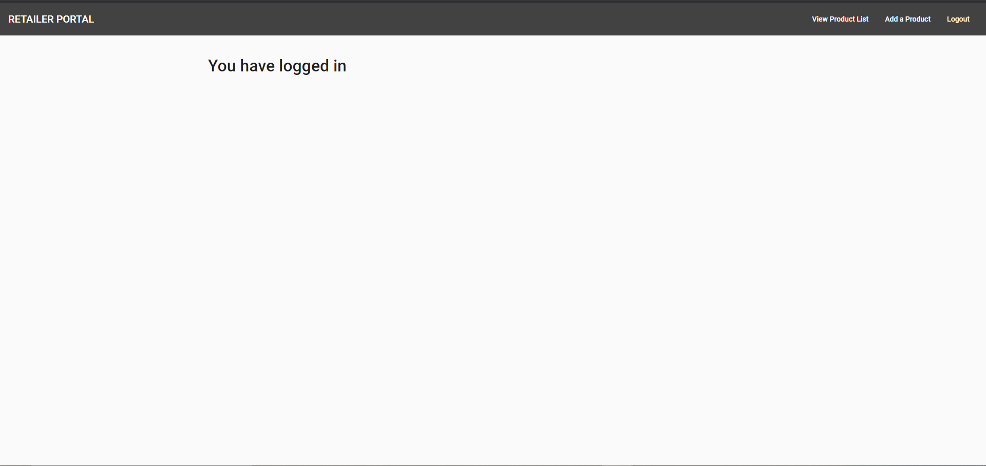
Retailer Module
Login Page

Slide 4
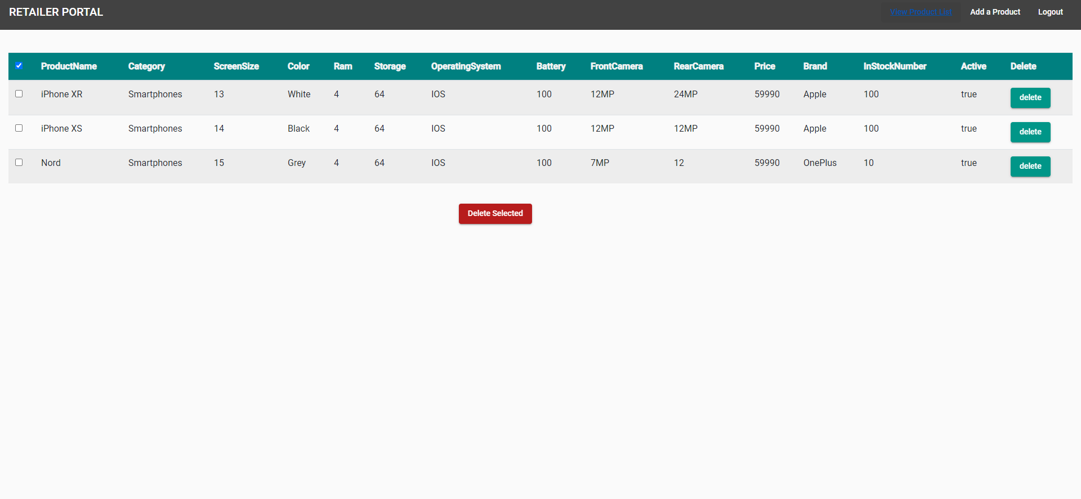
Retailer Module (contd.)
View Product List

Slide 5
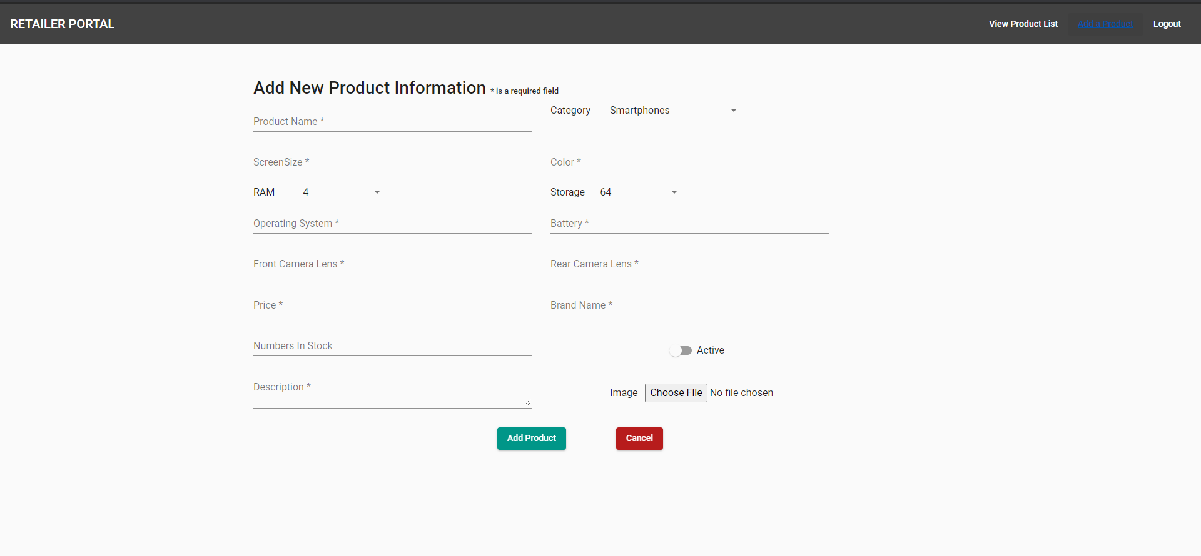
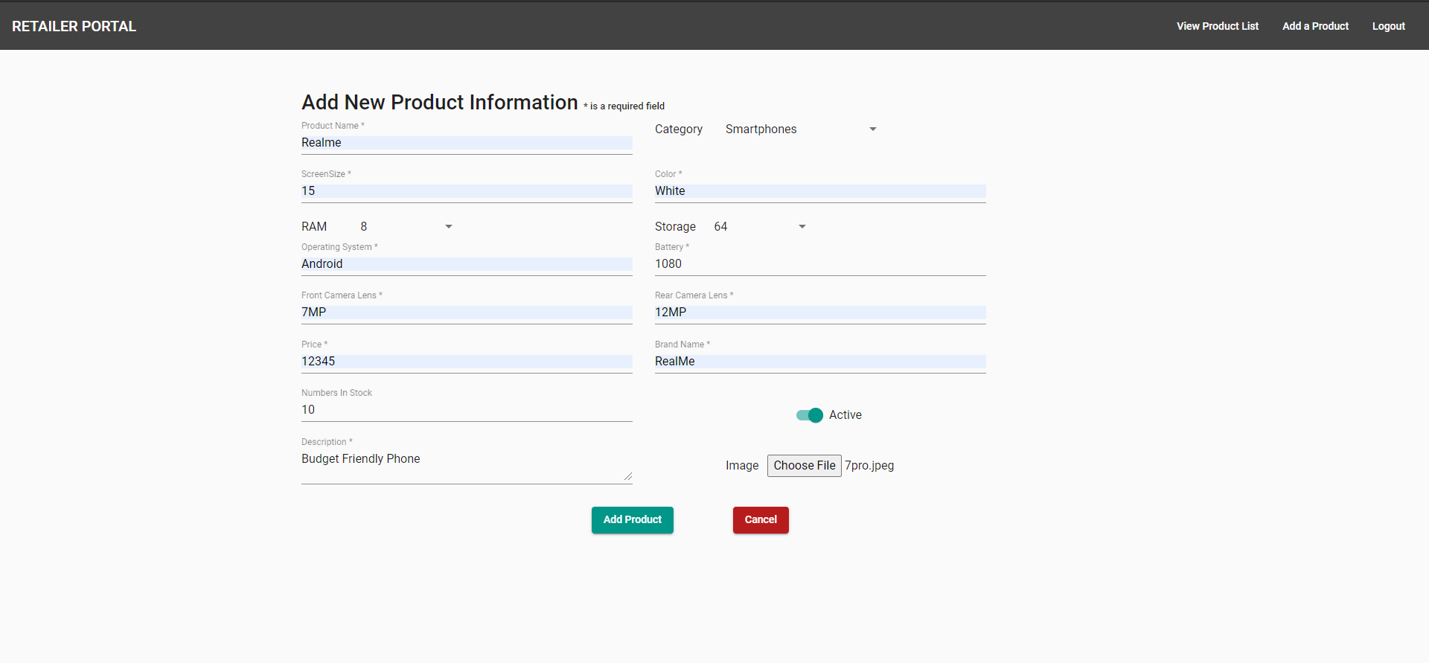
Retailer Module (contd.)
Add a product

Slide 6
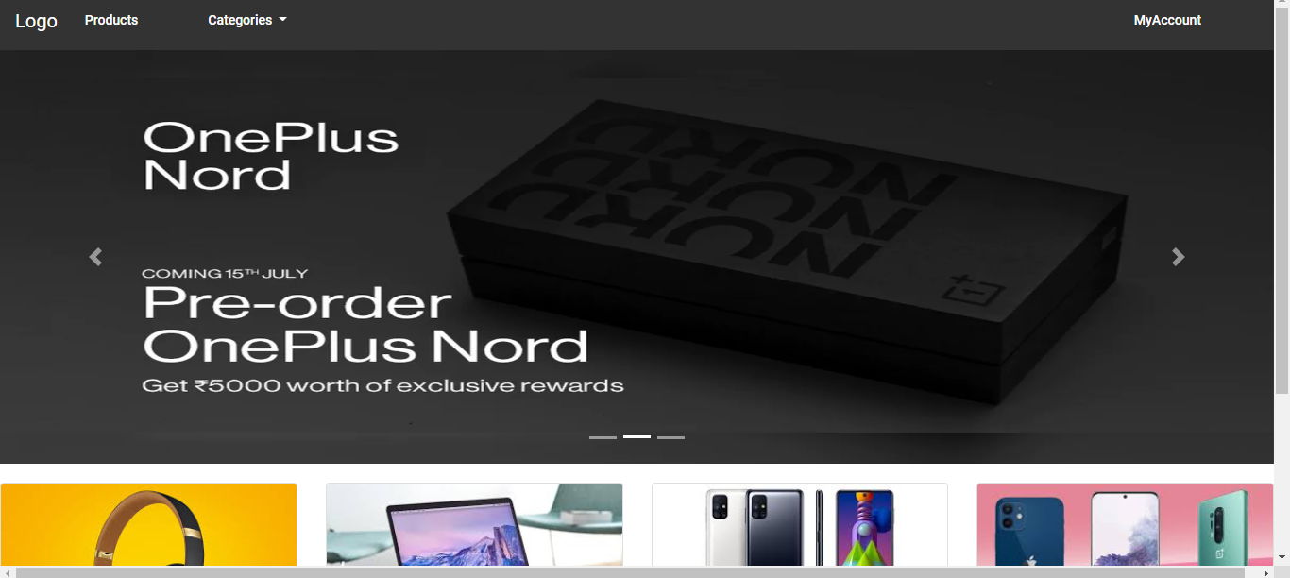
User Module
Home Page (before logging in)

Slide 7
User Module
Home Page (after logging in)

Slide 8
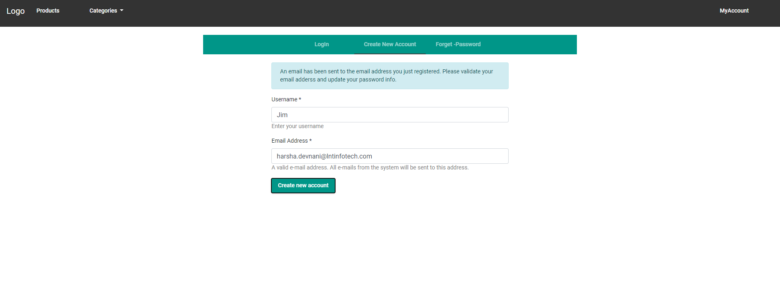
User Module (contd.)
Registration and Login

Slide 9
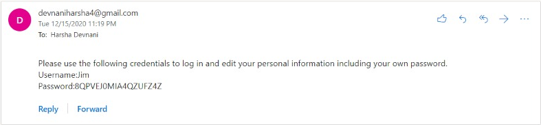
User Module (contd.)
Password generation during creation of New User and Forgot Password

Slide 10
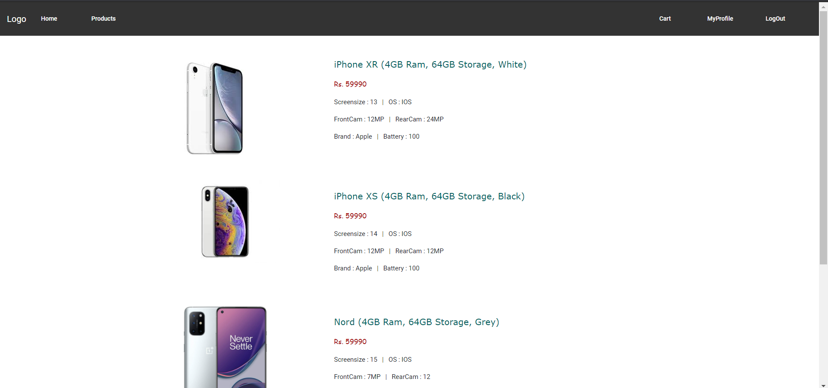
Retailer Module
Products

Slide 11
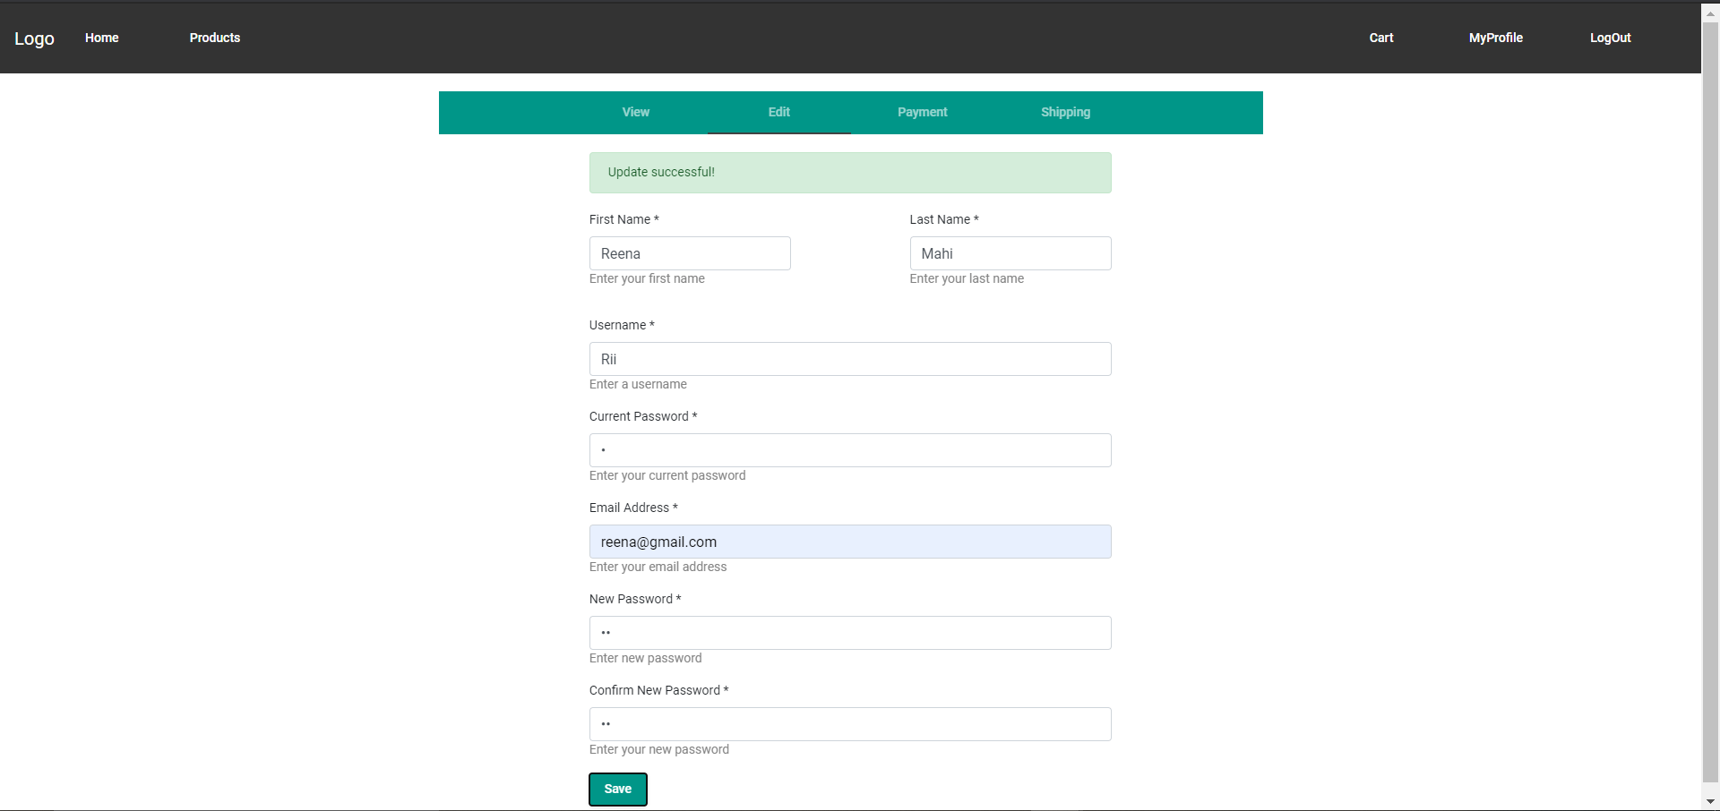
Retailer Module
Edit User Info

Slide 12
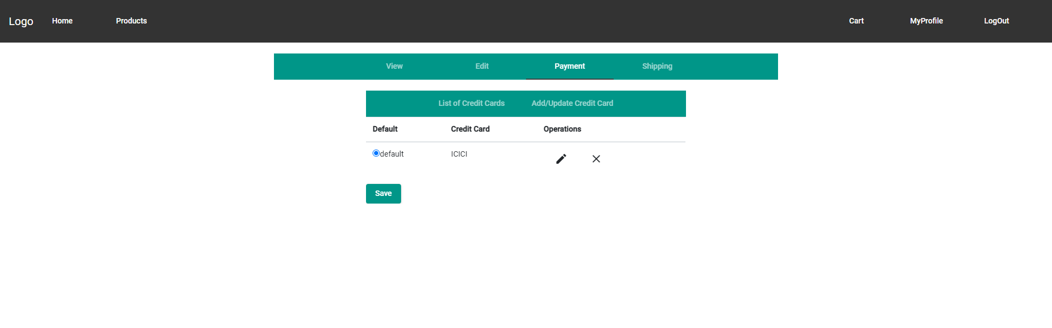
Retailer Module
Credit Card Info

Slide 13
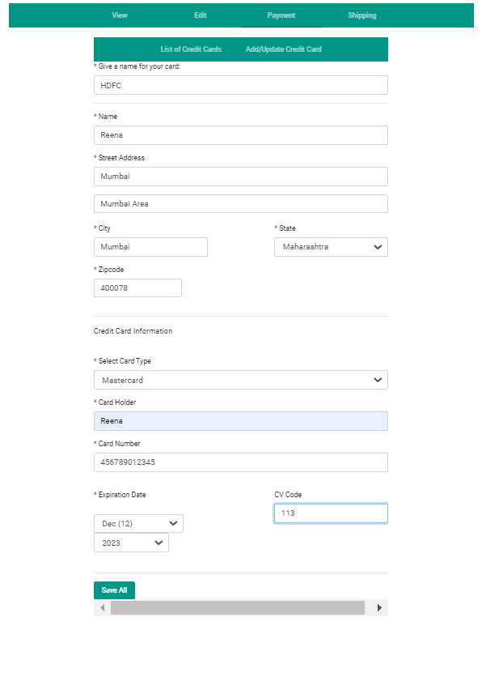
Retailer Module
Add / Edit Credit Card Info

Slide 14
Thank You

